Slide 1

Migration in Latin america
A Network Analysis Approach
Joey Hebl
Intro Network Analysis, Fall 2024

Slide 2
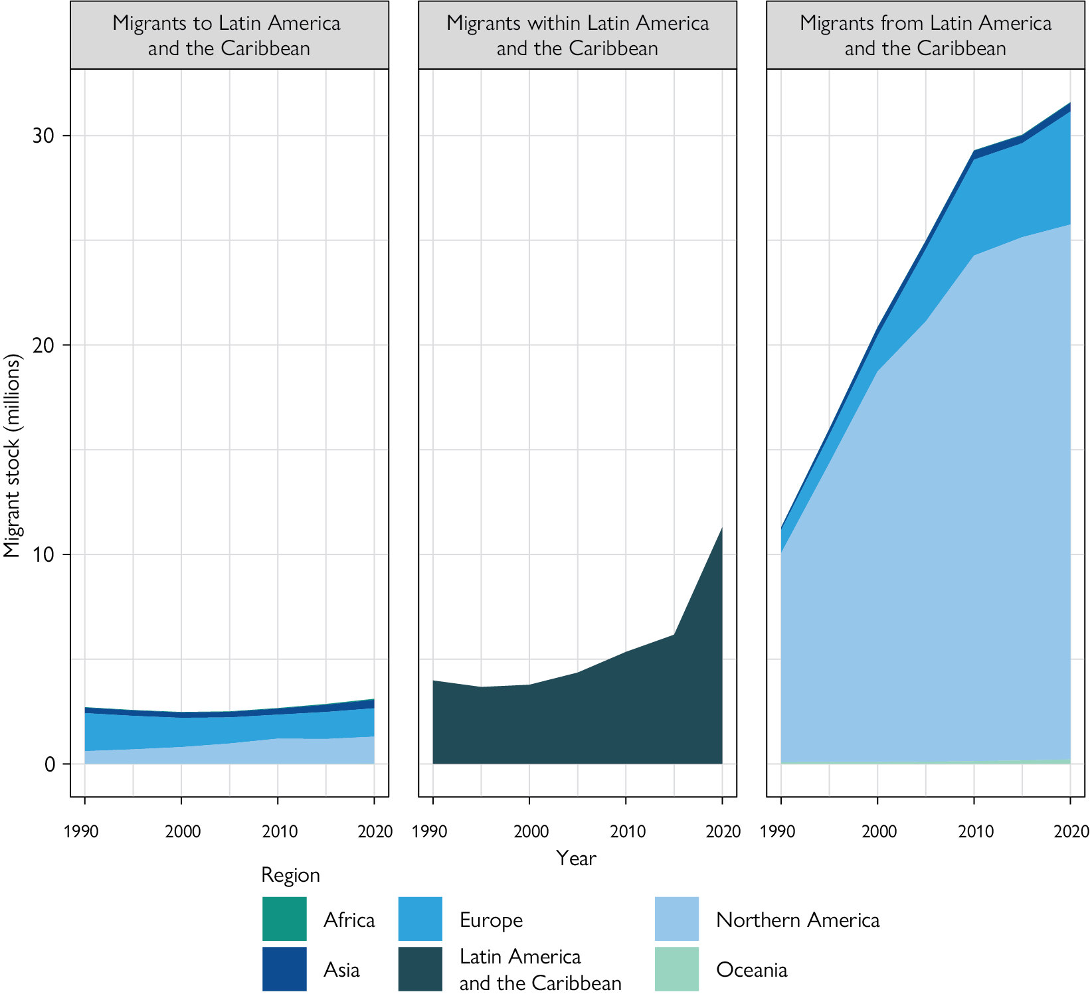
Migration
Increase Latin American and Caribbean (LAC) migration over past 30 years
World Migration Report
Notes:
Migrant stock: total number of immigrants living in a country who were not born there, including refugees.

Slide 3
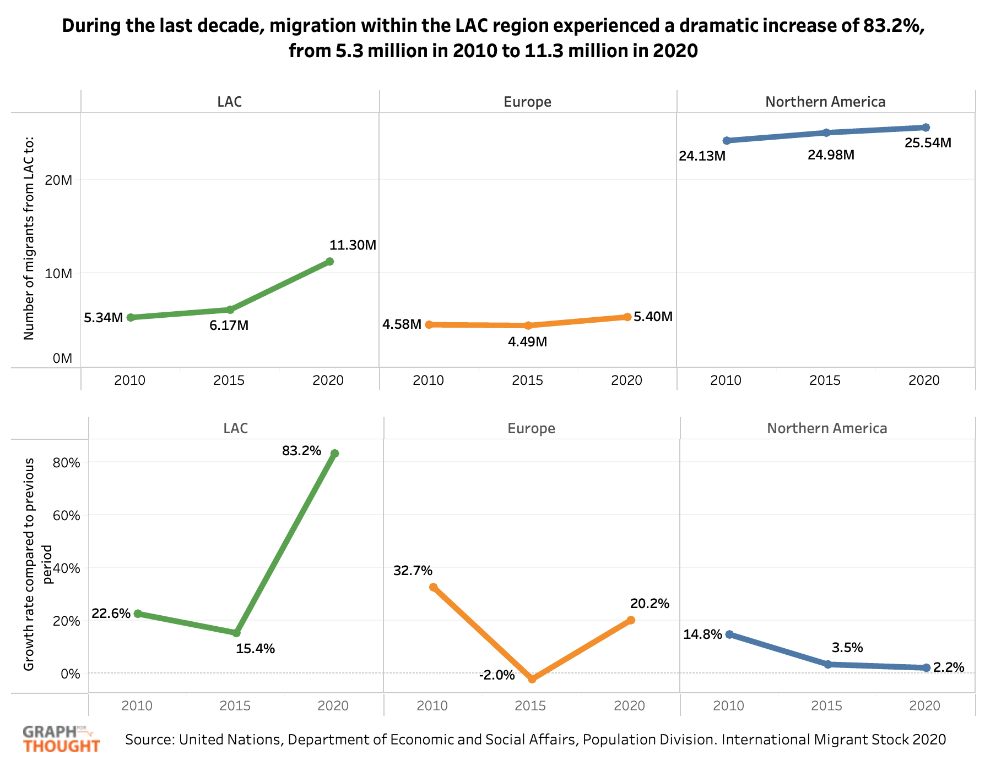
Migration
Increase rate in LAC migration within LAC
Dropping rate in LAC → North Am.
UNDP
Notes:
Migrant stock: total number of immigrants living in a country who were not born there, including refugees.

Slide 4
Proposal
Can a Network Analysis approach provide additional, useful, and more granular information for understanding the story of migration in Latin America over the past 30 years?

Slide 5

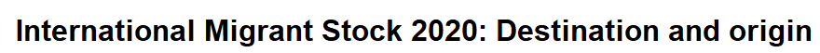
Data and Methods
Data from 19 LAC’s
Population >2million (no Caribbean…)
Origin and Destination
Data from:
1990
2000
2010
2020
Gathered from country-specific Census data…😬

Slide 6
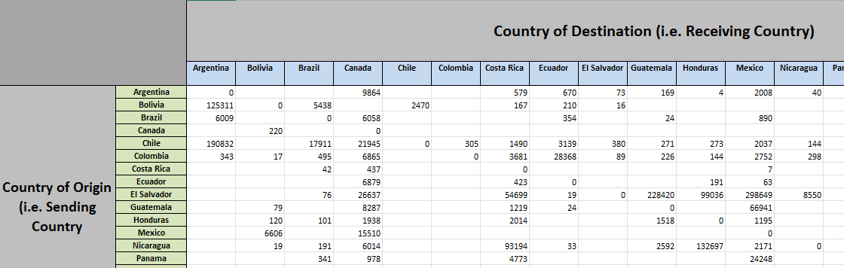
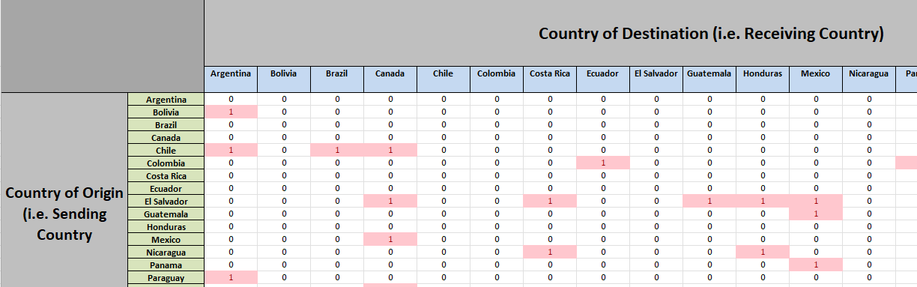
Data and Methods: cleaning
Adjacency matrix
Calculate differences to get “Net flow” btwn country pairs
Identify those net values that are >10,000 migrants
(1) Assign a value of 1 for simple matrix
Defines edge
(2) scale to country size (i.e. = value / 1000 citizens) → edge width
Provides edge width
Notes:
#### Notes #####
Data was collected from the UN website. Countries were filtered by those who have a minimum population of # 2 million. Parameter for edges is binary with threshold of 10,000 immigrants (i.e. if equal to or greater than# 10,000 immigrants, assigned a value of 1). The edges also represent net immigration, i.e. subtracting the # opposing migration pathways between two countries, with the direction of greater size dictating the edge direction,# though again, edges are only established if there is a minimum of 10,000 immigrants passing from one country to the # other after considering the net migration. Additionally, I added the edge attribute for thickness which is# associated with this value of net migration divided by the receiving country's population divided by 1000# (i.e. the units are x immigrants for every 1000 residents).

Slide 7
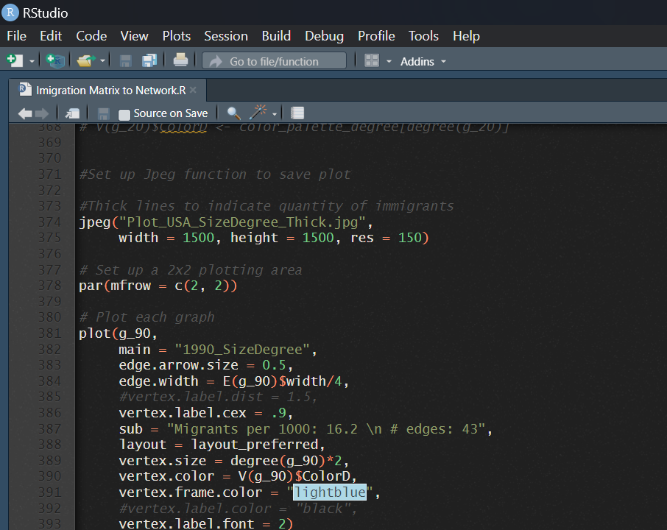
Data and Methods: Plotting
Create networks for each year
Vertex size and color by:
Degree: both “in” and “out”
Hubs: link to many other nodes; “out”
Authority: linked by many other nodes: “in”
Edges by:
Simple >10,000
Width based on migrant flow per 1000 citizens in receiving country
Removal of US to allow for more detailed assessment of LAC’s
Notes:
#### Notes #####
Data was collected from the UN website. Countries were filtered by those who have a minimum population of # 2 million. Parameter for edges is binary with threshold of 10,000 immigrants (i.e. if equal to or greater than# 10,000 immigrants, assigned a value of 1). The edges also represent net immigration, i.e. subtracting the # opposing migration pathways between two countries, with the direction of greater size dictating the edge direction,# though again, edges are only established if there is a minimum of 10,000 immigrants passing from one country to the # other after considering the net migration. Additionally, I added the edge attribute for thickness which is# associated with this value of net migration divided by the receiving country's population divided by 1000# (i.e. the units are x immigrants for every 1000 residents).

Slide 8
Results: Simplified-Binary Edges
Size and Color by Degree: With USA
Size and Color by Degree: Without USA
Size and Color by Hubs: With USA
Size and Color by Hubs: Without USA
Size and Color by Authority: With USA
Size and Color by Authority: Without USA
Notes:
Degree:
Increase across the board when reaching 2020
Numbers at bottom of each figure
Without US: Vz, Ca, Co, Mex, Arg
Degree size and color based on largest across all four networks
Hubs:
Chile
Vz
Co
Auth
Mex
Chile
Can
Vz

Slide 9
Results: Edge width scaled
Size and Color by Degree: With USA
Size and Color by Degree: Without USA
Size and Color by Hubs: With USA
Size and Color by Hubs: Without USA
Size and Color by Authority: With USA
Size and Color by Authority: Without USA

Slide 10

Take-aways
Increased Migration across 30 years
Nearly doubled rate, per this dataset.
Flip-floppers
Authority to Hub (receiver to sender)
Venezuela
Colombia (kinda)
Hub to Authority (sender to receiver)
Chile
Steady-Giants
Canada
USA
Balancing information vs clarity in network figures

Slide 11
Next Steps
QuAP
assess if one year’s arrangement of edges and vertexes predicts the next/subsequent year’s network
Correlation tests
Initial assessment found “in” vs “out” to be negatively correlated (intuitive)
Regression or T-Test based on…
Time-point (i.e. year)
Political ideology at given time-point
GDP (either raw, or based on status of “growing” or “shrinking”)
Presence of violence and/or climate crisis at given time-point
Additional thoughts??

